Slide 1
“Love Suicide at Kamaara” (1984)
Yoshida Sueko (1947-)

Slide 2
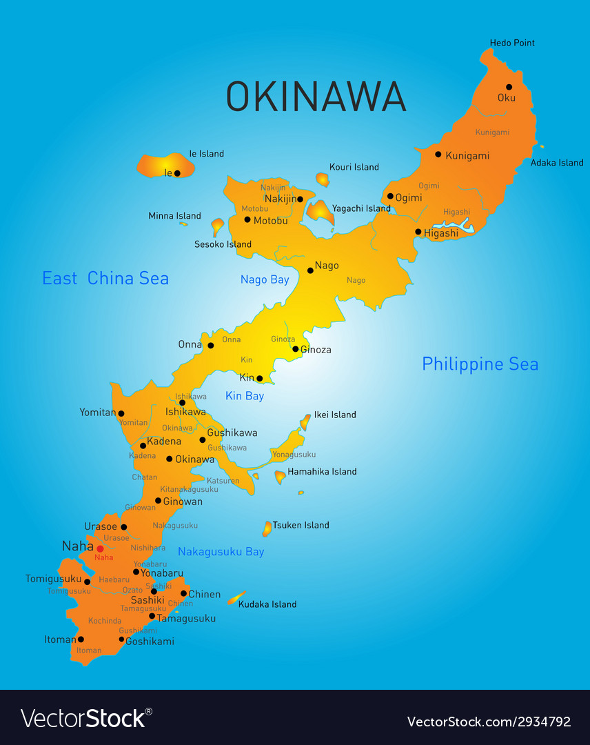
Map of Okinawa

Slide 3
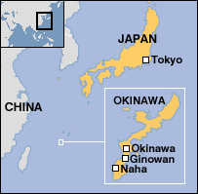
Okinawa Main Island: Koza above Ginowan

Slide 4
Map of Okinawa City (aka Koza)

Slide 5
Nakagusuku Castle

Slide 6
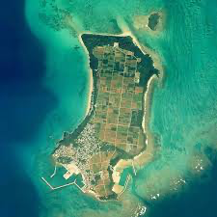
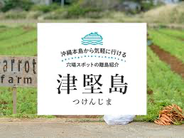
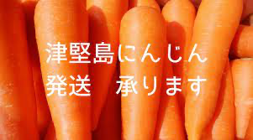
Tsuken Island

Slide 7
Keywords/Locations
Gate Street: starts from Gate 2 of Kadena AB and goes to Goya intersection; called Gate 2 street, renamed Airport Street
Goya Four Corners: left is notorious B.C. Street, right takes one to Nakagusuku Castle
B.C. Street: lined with bars, wild area during Vietnam War; renamed Central Park Avenue
Nakagusuku Castle: seat of the Central Kingdom (Shuri Castle is south and Nakijin Castle is north)
Tsuken and Iheya Islands, depopulation, akiya (empty houses)
Love suicide: shinjû

Slide 8
Discussion Questions
1. How is Kiyo depicted?
2. How is Sammy depicted?
3. What is the significance of Kiyo’s journey to Nakagusuku Park?
4. What is the significance of Kiyo’s choice to wear a traditional kimono?

